Slide 1
Implementation Of Soil Conservation Technique At Sannaspos Farm In Mangaung Metropolitan Municipality
                By
                Frans Joseph & Mias vd Westhuizen
Free State Department of Agriculture & Rural Development, Private Bag x01, Glen, 9360
email: frans@fs.agric.za
Tel: 051 861 8651
Sub-theme 4: Land Care and technology partnerships pathway

Slide 2
INTRODUCTION
Agriculture is one of the pillars of world economy
As one of the global economies, healthy agricultural industry that contributes to food security needs to be ensured
Natural resource degradation: Serious threat to world food security.

Slide 3
INTRODUCTION
Soil degradation (one of natural degradation): Change in the soil health status resulting in a diminished capacity to provide services like crop, rangeland and livestock production
Degradation involves loss of soil due to water or wind, depletion of nutrients or toxicity due to acidity or alkalinity, waterlogging and reduction in microbial activity

Slide 4
INTRODUCTION
World has lost third of its arable land in the past 40 years
This is due to erosion (physical degradation) or pollution (chemical degradation)
This will have a negative impact on global food demand in future
Soil degradation is also a reality in the Free State

Slide 5
INTRODUCTION
Contributing factors: inappropriate land use and agricultural practices
It is therefore very important to utilise agricultural lands sustainably to ensure long-term productivity
A research project/demonstration with the aim of implementing soil conservation technique to control gully erosion was implemented
Technique promotes siltation and vegetative growth in the gully

Slide 6
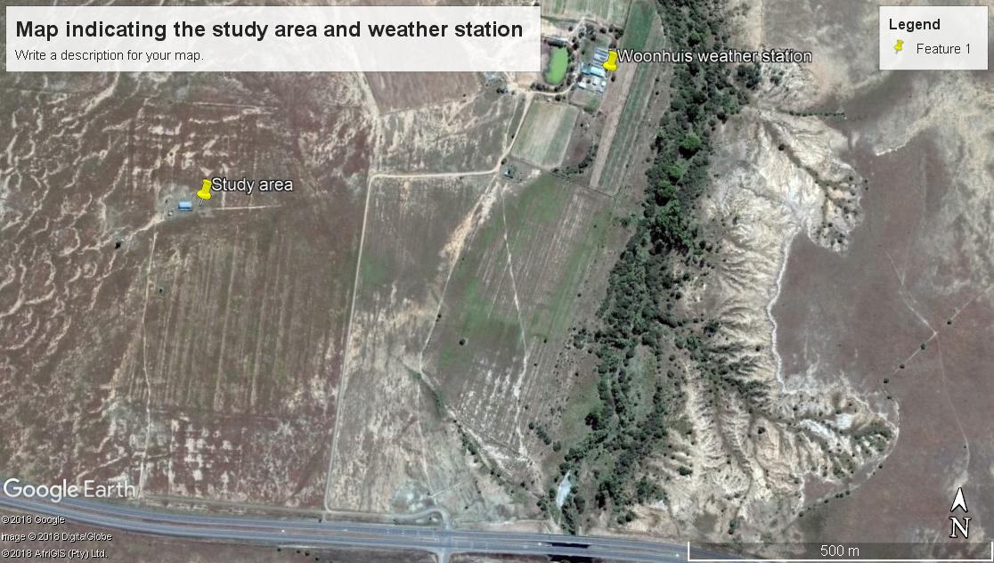
MATERIALS AND METHODS
Study area: 28 km east of Bloemfontein on the N8 road

Slide 7
MATERIALS AND METHODS
Farm: 227 ha in total; 203 ha veld & 24 ha for arable land
26 August 2016: 3 measuring points (gully depth) were identified
Measuring points: Deepest, medium and shallowest gully depths
Rainfall data from the weather station was also acquired
Soil described and classified according to SA classification

Slide 8
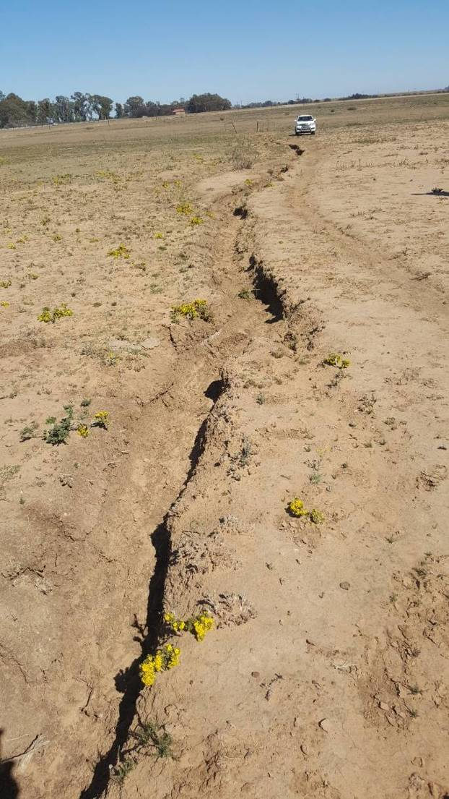
MATERIALS AND METHODS
Gully length: 240 m

Slide 9
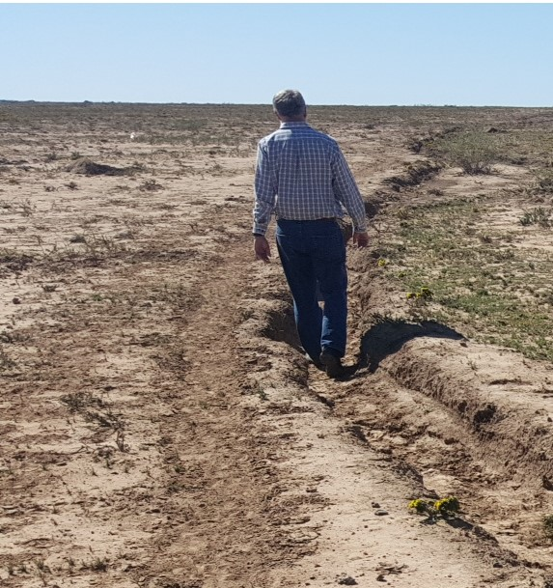
MATERIALS AND METHODS
Identification of measuring points:
Point 1: 70 cm
70 cm

Slide 10
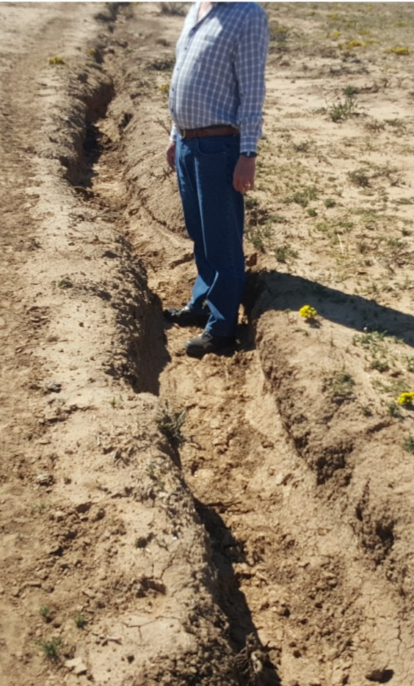
MATERIALS AND METHODS
Identification of measuring points:
Point 2: 45 cm
45 cm

Slide 11
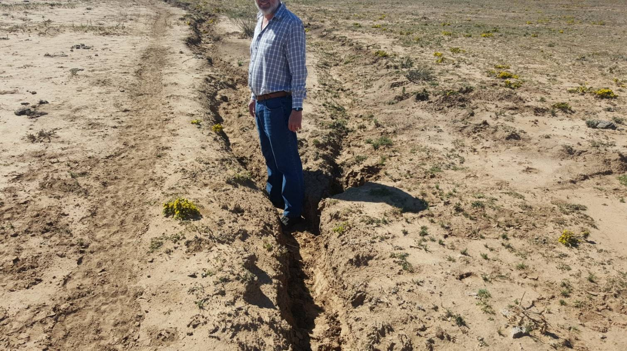
MATERIALS AND METHODS
Identification of measuring points:
Point 3: 35 cm
35 cm

Slide 12
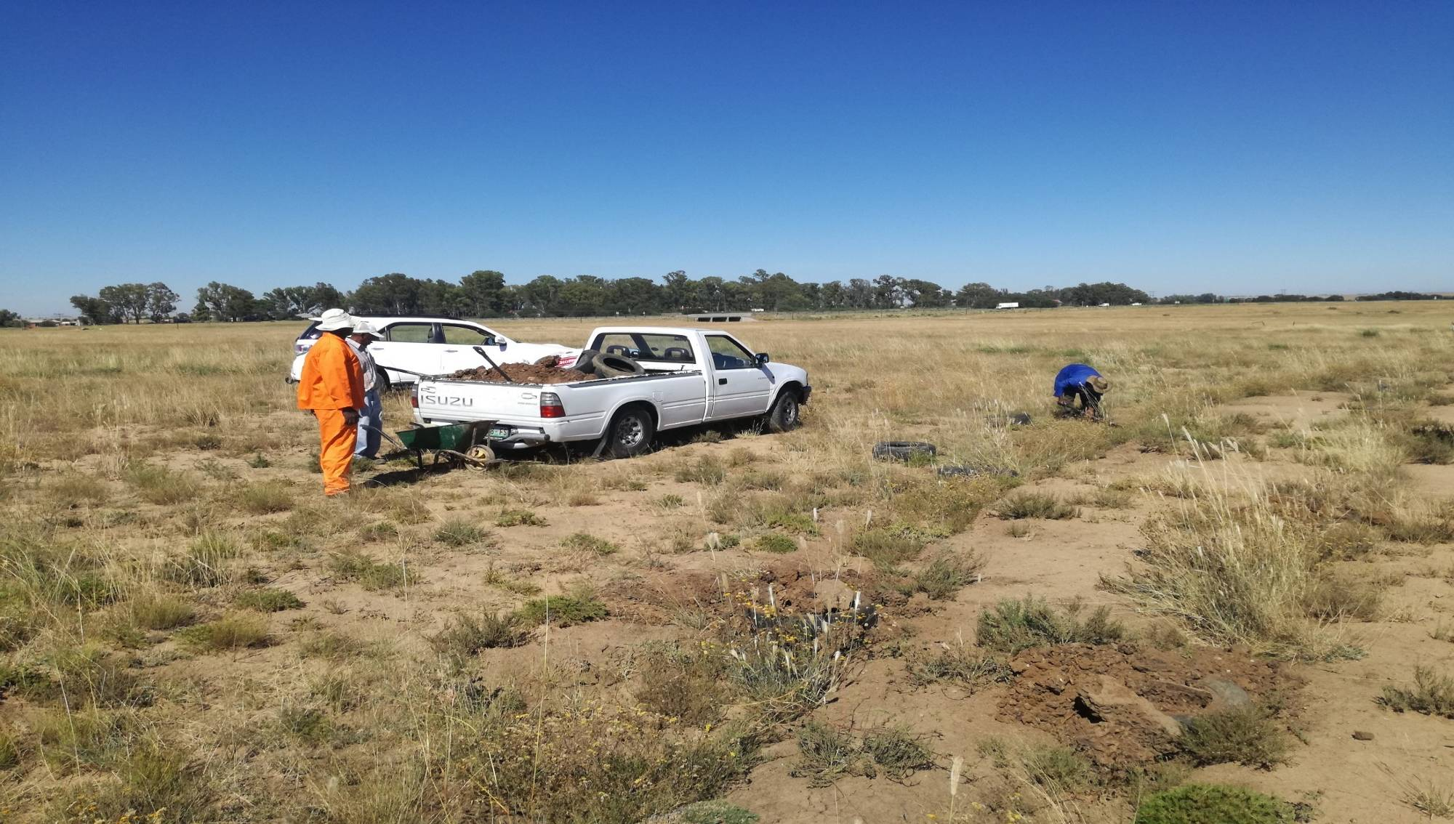
IMPLEMENTATION OF SOIL CONSERVATION TECHNIQUE (16 Feb 2017)

Slide 13
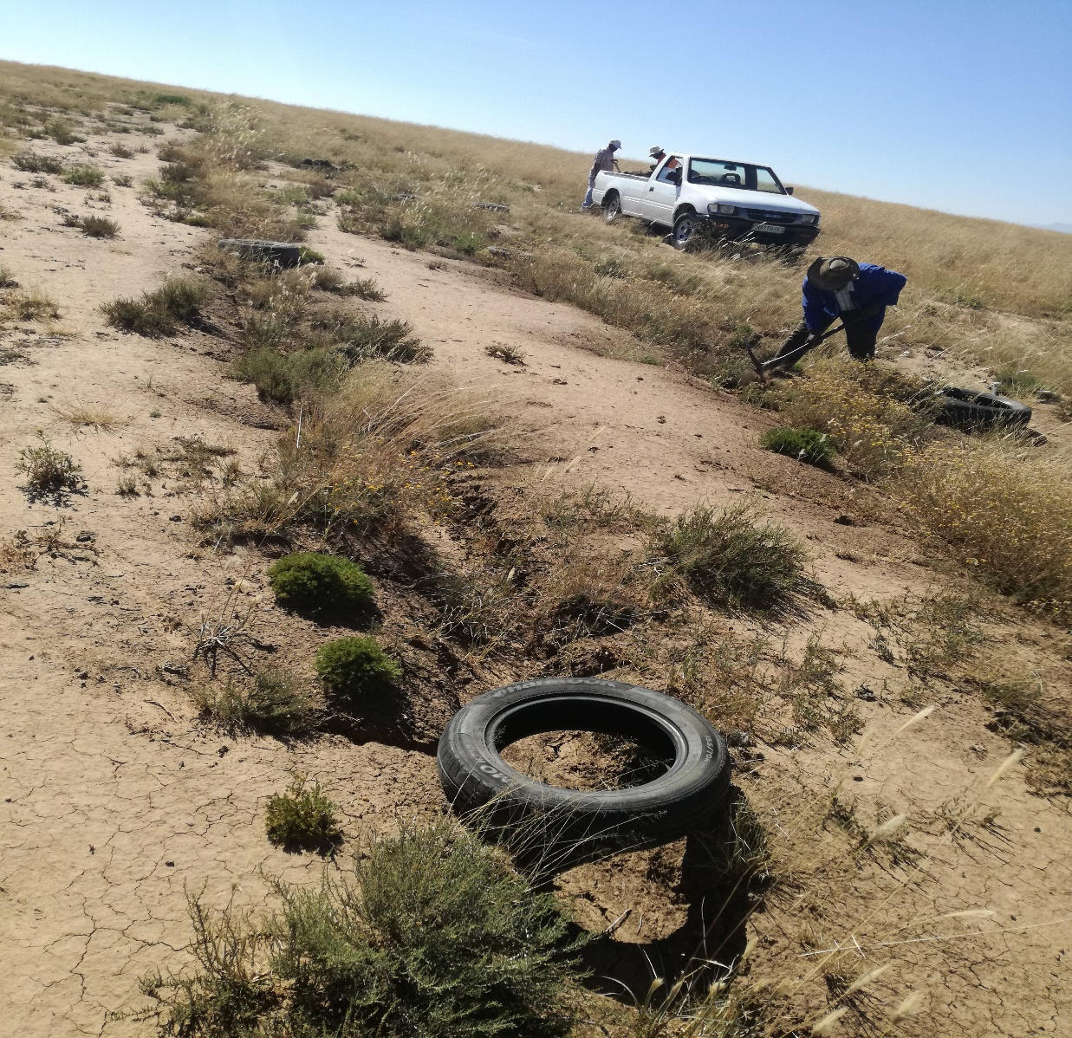
IMPLEMENTATION OF SOIL CONSERVATION TECHNIQUE (16 Feb 2017)

Slide 14
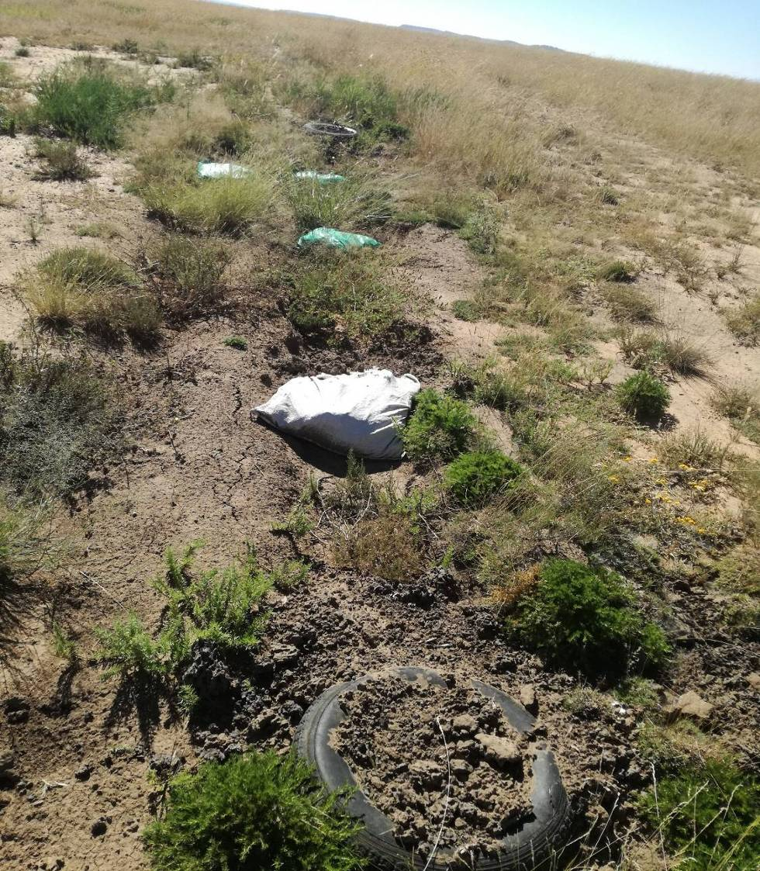
IMPLEMENTATION OF SOIL CONSERVATION TECHNIQUE (16 Feb 2017)

Slide 15
RESULTS
Soil form: Valsrivier
  Duplex soils: relatively permeable topsoils overlying very slowly permeable diagnostic B horizon
  Soils are prone to runoff which leads to water erosion

Slide 16
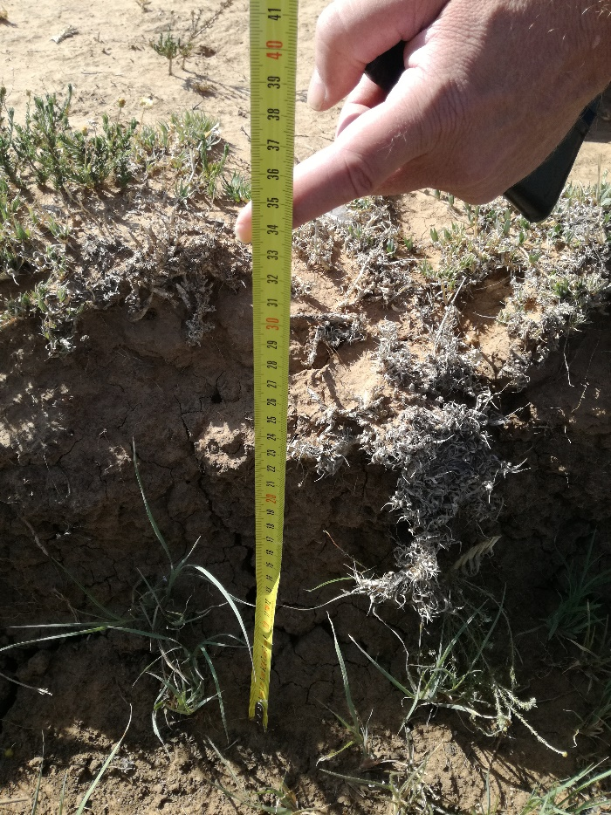
MONITORING: 10 JANUARY 2018_POINT 1
70 – 34 cm
51% decrease

Slide 17
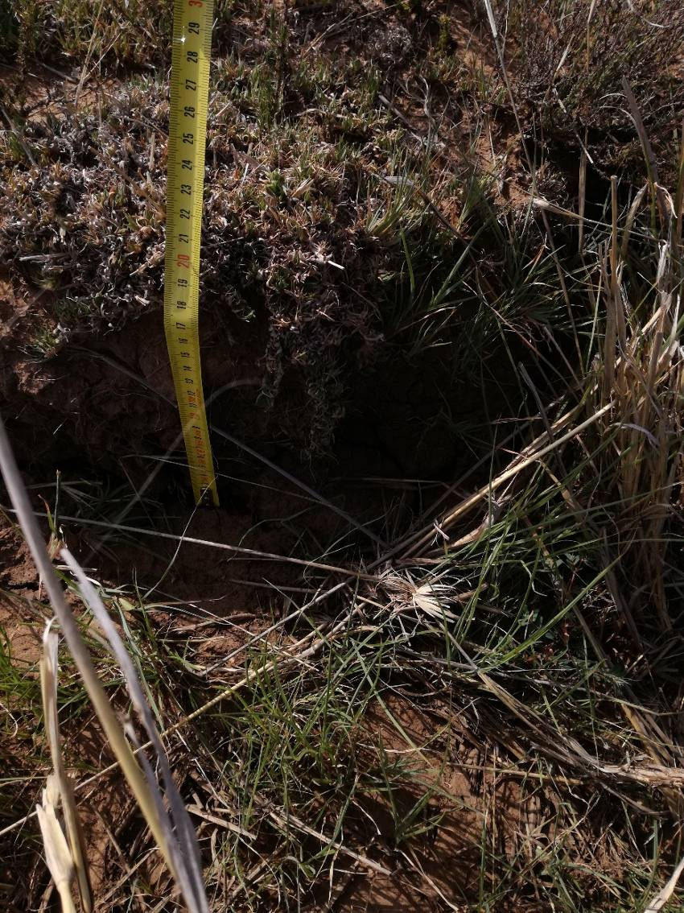
MONITORING: 10 JANUARY 2018_POINT 2
45 – 20 cm
56% decrease

Slide 18
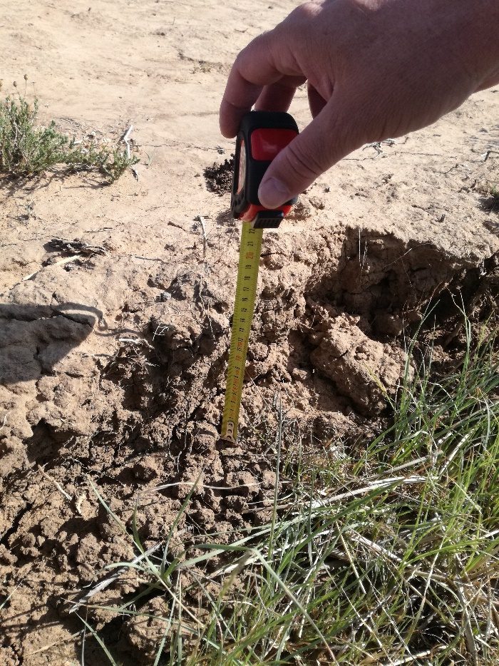
MONITORING: 10 JANUARY 2018_POINT 3
35 – 19 cm
46% decrease

Slide 19
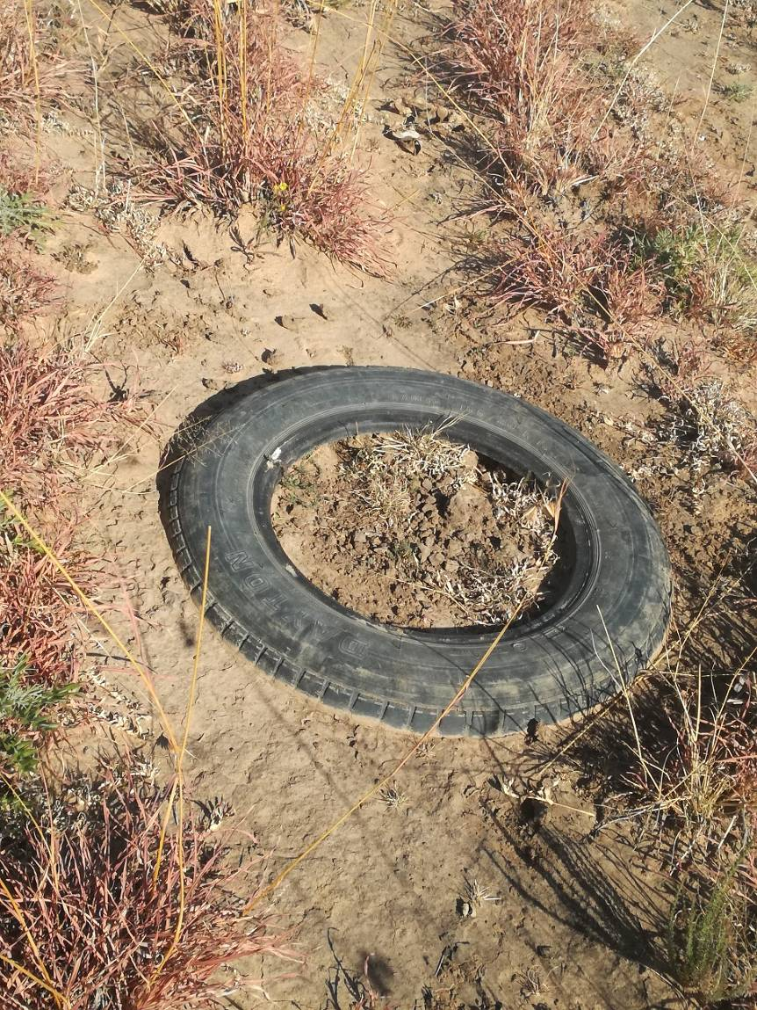
MONITORING: 10 JANUARY 2018
Sealed gully
  Not of one the 3 measured
Points but along the gully
Rainfall: 203 mm
  17/02/17 to 10/01/18

Slide 20
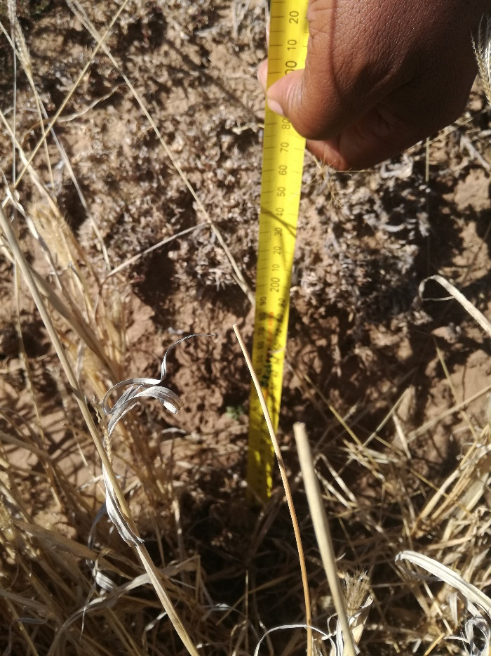
MONITORING: 01 AUGUST 2018_POINT 1
34 – 27 cm
21% decrease

Slide 21
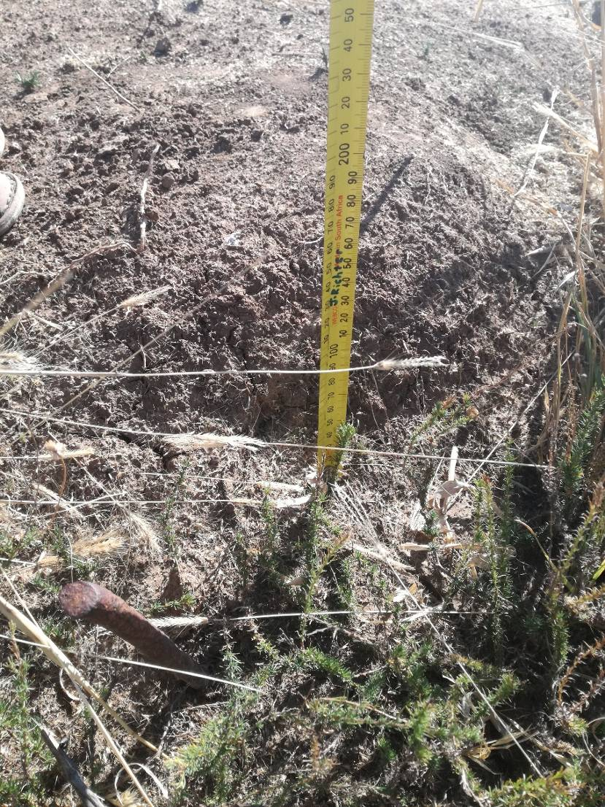
MONITORING: 01 AUGUST 2018_POINT 2
20 – 14 cm
30% decrease

Slide 22
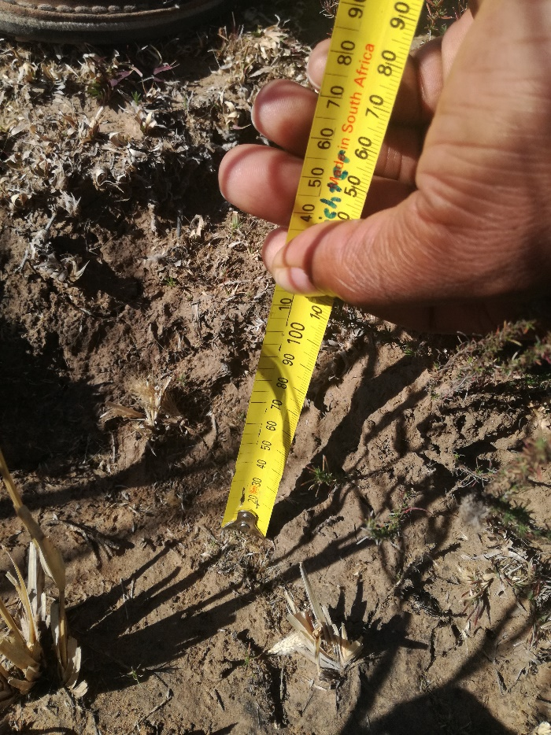
MONITORING: 01 AUGUST 2018_POINT 3
19 - 10 cm
47% decrease

Slide 23
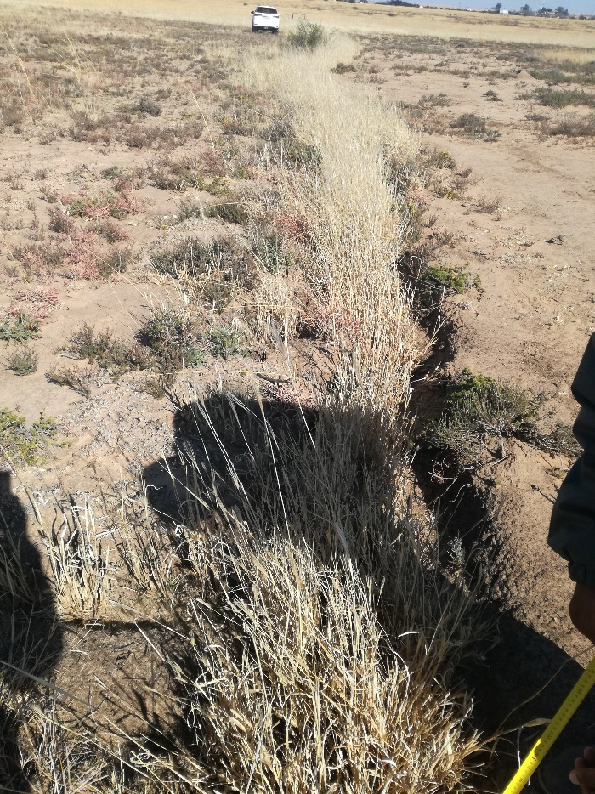
MONITORING: 01 AUGUST 2018
Current status
  Feather-top chloris dominating in the gully
Rainfall: 400 mm
  11/01/18 to 31/07/18

Slide 24
MONITORING: 10 JANUARY-01 AUGUST 2018
Change in species composition at the bottom and banks of the gully
  Annual feather-top chloris, pioneer grasses such as Aristida annual bristle grass & Cynodon hirsutus (hairy couch) occurred
  Sub climax grasses such as Eragrostis chloromellas (curly leaf) & E. lehmanniana (lehmann’s love grass) also germinated

Slide 25
MONITORING: 10 JANUARY-31 JULY 2018
Change in species composition at the bottom and banks of the gully
  Highly palatable shrub Felicia muricata as well as Rosenia humulis also increased
  Panicum stapfianum (small buffalo grass) & Themeda triandra (red grass) which are highly palatable grass species were also established

Slide 26
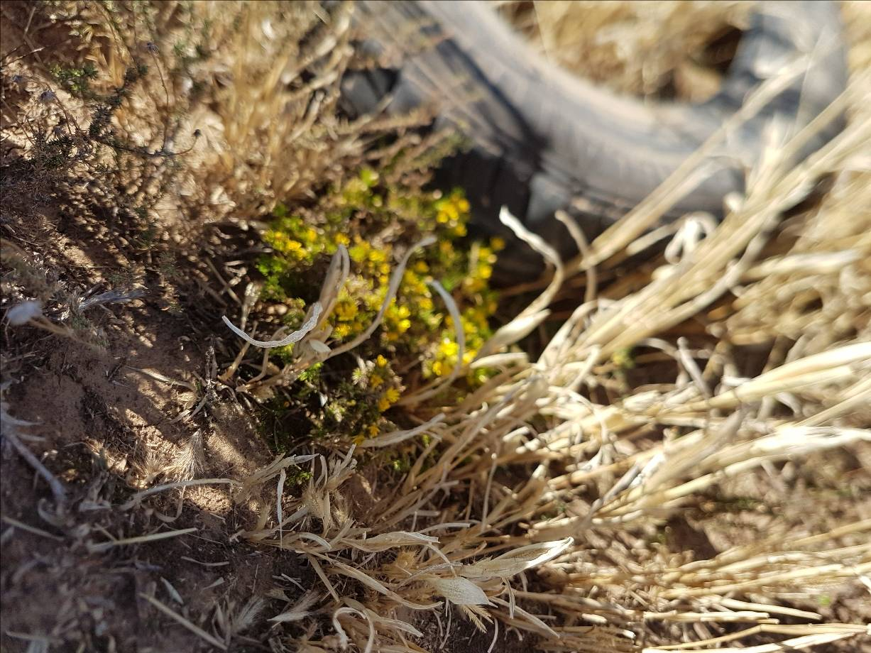
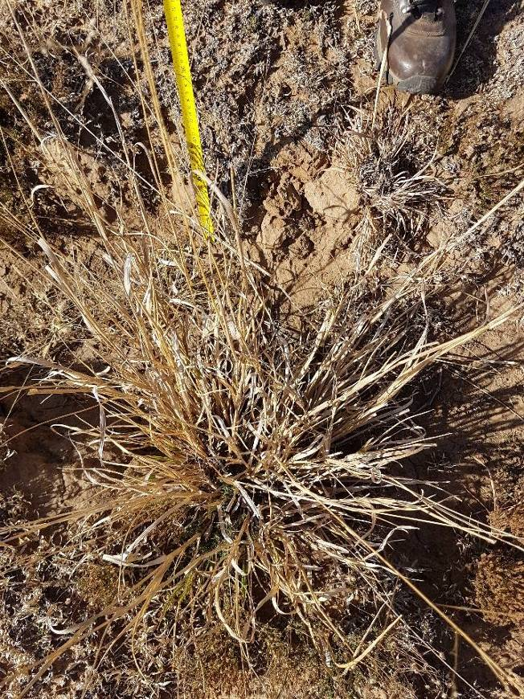
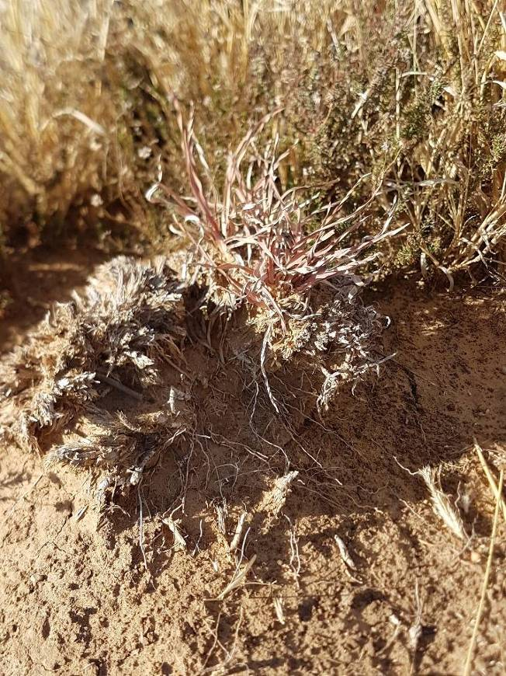
MONITORING: 10 JANUARY-01 AUGUST 2018
Small buffalo grass Red grass seedling Rosenia humulis (Karoo shrub)

Slide 27
MONITORING: 10 JANUARY-01 AUGUST 2018
Change in species composition at the bottom and banks of the gully
  Importance of T. trianda (red grass) as a key species for this vegetation type is continually emphasised since it is a very good indicator of rangeland condition

Slide 28
CONCLUSIONS & RECOMMENDATIONS
Since the implementation of the technique there is quantified decrease in gully depth (±42%)
There has also been an increase in grass species in the gully area
Sustainable rangeland management is essential
Since it is expensive to control gully erosion
Recommended that this very cheap method of controlling gully erosion be followed under similar conditions (climate, slope & soil)

Slide 29
THANK YOU!!!

